Slide 1
1354
IEEE TRANSACTIONS ON VERY LARGE SCALE INTEGRATION (VLSI) SYSTEMS, VOL. 26, NO. 7, JULY 2018
Optimizing the Convolution Operation to Accelerate Deep Neural Networks on FPGA
Yufei Ma , Student Member, IEEE, Yu Cao, Fellow, IEEE, Sarma Vrudhula , Fellow, IEEE, and Jae-sun Seo, Senior Member, IEEE
Abstract— As convolution contributes most operations in con- volutional neural network (CNN), the convolution acceleration scheme significantly affects the efficiency and performance of a hardware CNN accelerator. Convolution involves multiply and accumulate operations with four levels of loops, which results in a large design space. Prior works either employ limited loop optimization techniques, e.g., loop unrolling, tiling, and
when compared to software implementations on multicore processors with GPUs [10], [12], [13], [17]. This is due to the fact that modern FPGAs allow customization of the architecture and can exploit the availability of hundreds to thousands of on-chip DSP blocks. However, significant challenges remain in mapping CNNs onto FPGAs. The state- of-the-art CNNs require a large number (>1 billion) of compu- tationally intensive task (e.g., matrix multiplications on large numbers), involving a very large number of weights (>50 mil- lion) [4], [5]. Deep CNN algorithms have tens to hundreds of layers, with significant differences between layers in terms of sizes and configurations. The limited computational resources and storage capacity on FPGA make the task of optimal mapping of CNNs (e.g., minimizing latency subject to energy constraints or vice versa) a complex and multidimensional
interchange, or only tune some of the design variables after
the accelerator architecture and dataflow are already fixed. Without fully studying the convolution loop optimization before the hardware design phase, the resulting accelerator can hardly exploit the data reuse and manage data movement efficiently. This
paper overcomes these barriers by quantitatively analyzing and
RicardoNid
2020-10-05 13:52:53
--------------------------------------------
如何定量分析?有无提出模型?更重要的是,他 们看了什么书?
optimizing the design objectives (e.g., memory access) of the CNN
accelerator based on multiple design variables. Then, we propose
a specific dataflow of hardware CNN acceleration to minimize the data communication while maximizing the resource utilization to achieve high performance. The proposed CNN acceleration scheme and architecture are demonstrated by implementing end- to-end CNNs including NiN, VGG-16, and ResNet-50/ResNet-
optimization problem. The high cost of off-chip commu-
152 for inference. For VGG-16 CNN, the overall throughputs achieve 348 GOPS and 715 GOPS on Intel Stratix V and Arria
nication is another major impediment to achieving higher performance and lower energy. In fact, the energy cost associated with the large amount of data movements and memory accesses often exceeds the energy consumption of the computations [8], [20]. For these reasons, energy-efficient hardware acceleration of CNNs on a FPGA requires simulta- neous maximization of resource utilization and data reuse, and minimization of data communication.
More than 90% of the operations in a CNN involve con- volutions [2]–[4]. Therefore, it stands to reason that acceler- ation schemes should focus on the management of parallel computations and the organization of data storage and access across multiple levels of memories, e.g., off-chip dynamic random access memory (DRAM), on-chip memory, and local registers. In CNNs, convolutions are performed by four levels of loops that slide along both kernel and feature maps as shown in Fig. 1. This gives rise to a large design space consisting of various choices for implementing parallelism, sequencing of computations, and partitioning the large data set into smaller chunks to fit into on-chip memory. These problems can be handled by the existing loop optimiza- tion techniques [6], [9], such as loop unrolling, tiling, and
10 FPGAs, respectively.
Index Terms— Accelerator architectures, convolutional neural networks (CNNs), field-programmable gate array (FPGA), neural network hardware.
I. INTRODUCTION
T
HE field-programmable gate arrays (FPGA) are fast becoming the platform of choice for accelerating the
inference phase of deep convolutional neural networks (CNNs). In addition to their conventional advantages of recon-
figurability and shorter design time over application-specific integrated circuits (ASICs) [20], [21] to catch up with the rapid evolving of CNNs, FPGA can realize low latency infer- ence with competitive energy efficiency (∼10–50 GOP/s/W)
Manuscript received October 27, 2017; revised February 3, 2018; accepted
March 6, 2018. Date of publication April 3, 2018; date of current version June 26, 2018. This work was supported in part by the NSF I/UCRC Center for Embedded Systems through NSF under Grant 1230401, Grant 1237856, Grant 1701241, Grant 1361926, Grant 1535669, Grant 1652866, and Grant 1715443; and in part by the Intel Labs, and in part by the Samsung Advanced Institute of Technology. (Corresponding author: Yufei Ma.)
Y. Ma, Y. Cao, and J.-s. Seo are with the School of Electrical, Computer, and Energy Engineering, Arizona State University, Tempe, AZ 85287 USA (e-mail: yufeima@asu.edu; yu.cao@asu.edu; jaesun.seo@asu.edu).
S. Vrudhula is with the School of Computing, Informatics, Decision Systems Engineering, Arizona State University, Tempe, AZ 85287 USA (e-mail: vrudhula@asu.edu).
Color versions of one or more of the figures in this paper are available online at http://ieeexplore.ieee.org.
Digital Object Identifier 10.1109/TVLSI.2018.2815603
RicardoNid
2020-10-05 13:59:36
--------------------------------------------
tiling和interchange的优化点在何?tiling和 unrolling的区别?
interchange. Although some CNN accelerators have adopted
these techniques [9], [11], [13], [19], the impact of these techniques on design efficiency and performance has not been systematically and sufficiently studied. Without fully studying the loop operations of convolutions, it is difficult to efficiently customize the dataflow and architecture for high- throughput CNN implementations. This paper aims to address
1063-8210 © 2018 IEEE. Personal use is permitted, but republication/redistribution requires IEEE permission.
See http://www.ieee.org/publications_standards/publications/rights/index.html for more information.

Slide 2
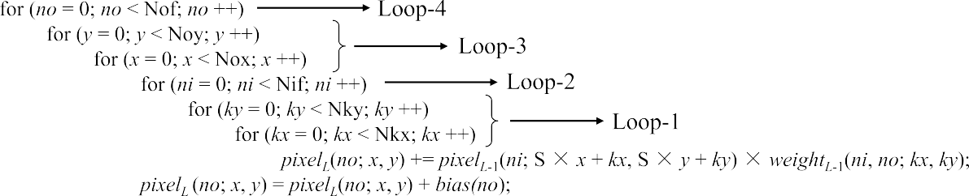
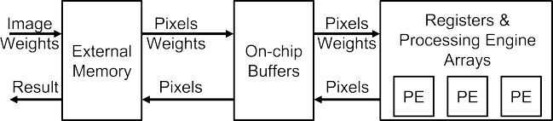
MA et al.: OPTIMIZING CONVOLUTION OPERATION TO ACCELERATE DEEP NEURAL NETWORKS ON FPGA
1355
Fig. 1.
Four levels of convolution loops,
where L denotes the index of convolution layer and S denotes the sliding stride [15].
RicardoNid
2020-10-05 13:56:03
--------------------------------------------
6层for循环,x-y同质,视为一层,四层循环
these shortcomings. Specifically, the main contributions of this paper include the following.
1) We provide an in-depth analysis of the three loop
optimization techniques for convolution operations and
use corresponding design variables to numerically char- acterize the acceleration scheme.
2) The design objectives of CNN accelerators (e.g., latency,
memory) are quantitatively estimated based on the con- figurations of the design variables.
3) An efficient convolution acceleration strategy and
Fig. 2. Three levels of general hardware CNN accelerator hierarchy.
dataflow is proposed aimed at minimizing data commu-
engines (PEs), as shown in Fig. 2. The basic flow is to fetch data from external memory to on-chip buffer, and then feed them into registers and PEs. After the PE computation completes, results are transferred back to on-chip buffers and to the external memory if necessary, which will be used as input to the subsequent layer.
nication and memory access.
4) A data router is designed to handle different settings
for convolution sliding operations, e.g., strides and zero
paddings, especially for highly irregular CNNs.
A corresponding hardware architecture is designed that fully utilizes the computing resources for high perfor- mance and efficiency, which is uniform and reusable for all the layers.
The proposed acceleration scheme and architecture is validated by implementing large-scale deep CNN algo-
rithms, NiN [3], VGG-16 [4], and ResNet-50/ResNet- 152 [5] for image recognition [1], on two Intel FPGAs.
The proposed accelerators achieve end-to-end inference throughput of 715 GOPS on Arria 10 and 348 GOPS on
Stratix V, respectively, using a batch size of 1.
The rest of this paper is organized as follows. Section II identifies the key design variables that are used to numerically
B. Convolution Loops
Convolution is the main operation in CNN algorithms, which involves 3-D multiply-and-accumulate (MAC) opera-
tions of input feature maps and kernel weights. Convolution is implemented by four levels of loops as shown in the pseudocodes in Fig. 1 and illustrated in Fig. 3. To efficiently map and perform the convolution loops, three loop optimiza- tion techniques [6], [9], namely, loop unrolling, loop tiling, and
loop interchange, are employed to customize the computation
characterize the loop optimization techniques. Section III con- tains a quantitative analysis of hardware accelerator objectives.
and communication patterns of the accelerator with three levels of memory hierarchy.
Section IV describes the acceleration schemes used in some
C. Loop Optimization and Design Variables
As shown in Fig. 3, multiple dimensions are used to describe the sizes of the feature and kernel maps of each convolution layer for a given CNN. The hardware design variables of loop unrolling and loop tiling will determine the acceleration factor
of the recent state-of-the-art CNN accelerators. Section V presents the optimized acceleration scheme with specific design variables. A corresponding dataflow and architecture is proposed in Section VI. Section VII analyzes the experi- mental results and compares with prior works. Conclusions are presented in Section VIII.
and hardware footprint. All dimensions and variables used in
this paper are listed in Table I.
II. ACCELERATION OF CONVOLUTION LOOPS
A. General CNN Acceleration System
Recently reported CNN algorithms involve a large amount of data and weights. For them, the on-chip memory is insuf- ficient to store all the data, requiring gigabytes of external memory. Therefore, a typical CNN accelerator consists of
The width and height of one kernel (or filter) window is described by (Nkx, Nky). (N ix , Niy) and (Nox, Noy) define the width and height of one input and output feature map (or channel), respectively. Nif and Nof denote the number of input and output feature maps, respectively. The loop unrolling design variables are (Pkx, Pky), Pif, (Pox, Poy), and Pof, which denote the number of parallel computations. The loop tiling
three levels of storage hierarchy: 1) external memory; 2) on-
design variables are (Tkx, Tky), Tif, (Tox, Toy), and Tof, which represent the portion of data of the four loops stored in on-chip
chip buffers; and 3) registers associated with the processing

Slide 3





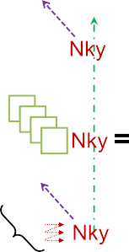
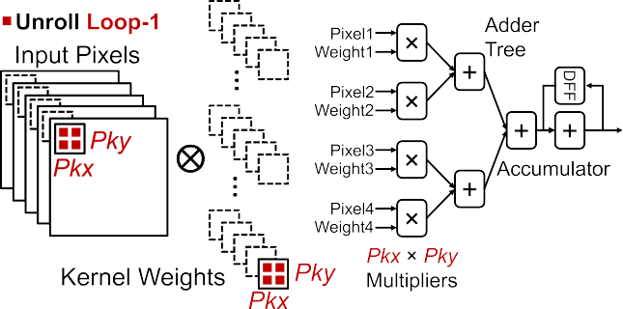
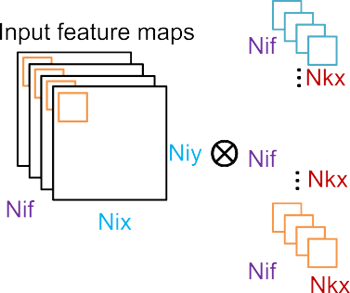
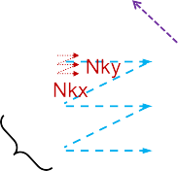
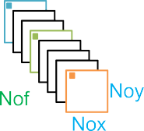




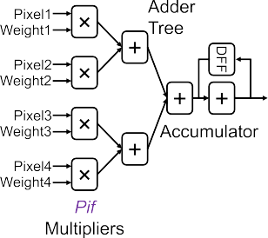
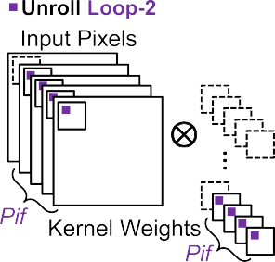

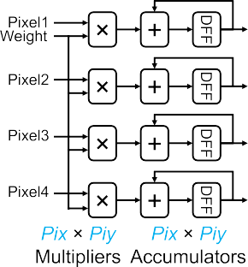
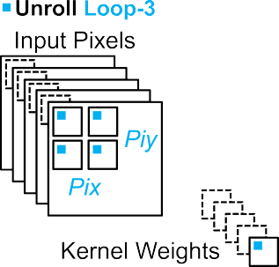
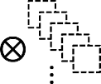
1356
IEEE TRANSACTIONS ON VERY LARGE SCALE INTEGRATION (VLSI) SYSTEMS, VOL. 26, NO. 7, JULY 2018
TABLE I
CONVOLUTION LOOP DIMENSIONS AND HARDWARE DESIGN VARIABLES
Fig. 4.
Unroll loop-1 and its corresponding computing architecture.
Fig. 3.
Four levels of convolution loops and their dimensions.
buffers. The constraints of these dimension and variables are given by 1 ≤ P∗ ≤ T∗ ≤ N∗, where N∗, T∗, and P∗ denote any dimension or variable that has a prefix of capital N, T, and P, respectively. For instance, 1≤ Pkx ≤ Tkx ≤ Nkx. By default, P∗, T∗ and N ∗ are applied to all convolution layers.
The relationship of input and output variables is constraint
by (1)–(3), where S is the stride of the sliding window and
Fig. 5.
Unroll loop-2 and its corresponding computing architecture.
the zero padding size is included in Nix, Niy, Tix, and Tiy
Nix = (Nox − 1)S + Nkx Niy = (Noy − 1)S + Nky Tix = (Tox − 1)S + Nkx Tiy = (Toy − 1)S + Nky Pix = Pox
Piy = Poy.
(1)
(2)
(3)
1) Loop Unrolling: As illustrated in Figs. 4–7, unrolling
RicardoNid
2020-10-05 15:09:25
--------------------------------------------
这部分内容,图片比文字更直接
different convolution loops leads to different parallelization of computations, which affects the optimal PE architecture with respect to data reuse opportunities and memory access patterns.
a) Loop-1 unrolling (Fig. 4): In this case, the inner
Fig. 6.
Unroll loop-3 and its corresponding computing architecture.
product of Pkx × Pky pixels (or activations) and weights from
same (x , y) location are required to compute the inner product. The inner-product operation results in the same computing structure as in unrolling Loop-1, but with a different adder tree fan-in of Pif.
different (x , y) locations in the same feature and kernel map are computed every cycle. This inner product requires an adder
tree with fan-in of Pkx × Pky to sum the Pkx × Pky parallel
multiplication results, and an accumulator to add the adder tree output with the previous partial sum.
b) Loop-2 unrolling (Fig. 5): In every cycle, Pif number of pixels/weights from Pif different feature/kernel maps at the
c) Loop-3 unrolling (Fig. 6): In every cycle, Pix × Piy
number of pixels from different (x , y) locations in the same
feature map are multiplied with the identical weight. Hence, this weight can be reused Pix × Piy times. Since the Pix ×

Slide 4

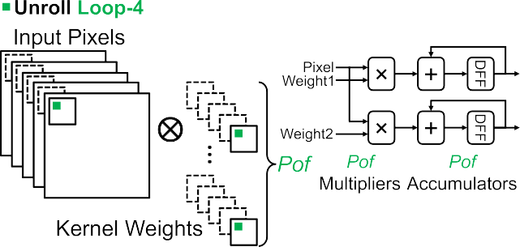


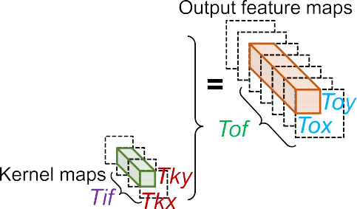
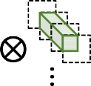

MA et al.: OPTIMIZING CONVOLUTION OPERATION TO ACCELERATE DEEP NEURAL NETWORKS ON FPGA
1357
3) Loop Interchange: Loop interchange determines the order of the sequential computation of the four convo- lution loops. There are two kinds of loop interchange, namely, intratile and intertile loop orders.
 |  | Intratile loop order
determines the pattern of data movements from on-chip buffer
to PEs. Intertile loop order determines the data movement from
external memory to on-chip buffer.
III. ANALYSIS ON DESIGN OBJECTIVES OF CNN ACCELERATOR
Fig. 7. Unroll loop-4 and its corresponding computing architecture.
In this section, we provide a quantitative analysis of the
impact of loop design variables (P∗ and T∗) on the following
design objectives that our CNN accelerator aims to minimize.
A. Computing Latency
RicardoNid
2020-10-05 15:29:09
--------------------------------------------
这里的latency = II,因此也直接决定throughput
The number of multiplication operations per layer (Nm) is
Nm = Nif × Nkx × Nky × Nof × Nox × Noy. (5)
Ideally, the number of computing cycles per layer should be Nm/Pm, where Pm is the number of multipliers. However, for
different loop unrolling and tiling sizes, the multipliers cannot necessarily be fully utilized for every convolution dimension.
The number of actual computing cycles per layer is
#_cycles = #intertile_cycles × #intratile_cycles (6) where
#intertile_cycles = JNif /Tif ]JNkx/Tkx]JNky/Tky]
×JNof /Tof ]JNox/Tox]JNoy/Toy] (7) #intratile_cycles = JTif /Pif ]JTkx/Pkx]JTky/Pky]
×JTof /Pof ]JTox/Pox]JToy/Poy]. (8)
Here, we assume that the multipliers receive input data
Fig. 8. Loop tiling determines the size of data stored in on-chip buffers.
Piy parallel multiplication contributes to independent Pix ×
Piy output pixels, Pix × Piy accumulators are used to serially
accumulate the multiplier outputs and no adder tree is needed.
d) Loop-4 unrolling (Fig. 7): In every cycle, one pixel is multiplied by Pof weights at the same (x , y) location but from Pof different kernel maps, and this pixel is reused Pof times. The computing structure is identical to unrolling Loop-3 using Pof multipliers and accumulators without an adder tree.
continuously without idle cycles. If the ratio of N ∗ to T∗ or T∗
The unrolling variable values of the four convolution loops
to P∗ is not an integer, the multipliers or the external memory
collectively determine the total number of parallel MAC
transactions are not fully utilized. In addition to considering computing latency, memory transfer delay must also be con- sidered for the overall system latency.
operations as well as
the number of required multipliers (Pm)
Pm = Pkx × Pky × Pif × Pix × Piy × Pof . (4)
2) Loop Tiling: On-chip memory of FPGAs is not always large enough to store the entire data of deep CNN algorithms. Therefore, it is reasonable to use denser external DRAMs to store the weights and the intermediate pixel results of all layers.
B. Partial Sum Storage
A partial sum (psum) is the intermediate result of the inner-product operation that needs to be accumulated over several cycles to obtain one final output data. Therefore, partial
sums need to be stored in memory for the next few cycles
and sometimes have to be moved between PEs. An efficient
RicardoNid
2020-10-05 15:35:16
--------------------------------------------
 | Loop tiling is used to |  | divide | the | entire | data | into multiple
blocks, which can be accommodated in the on-chip buffers,
as illustrated in Fig. 8. |  | With proper assignments of the loop
tiling size, the locality of data can be increased
acceleration strategy has to minimize the number of partial
sums and process them locally as soon as possible to reduce
data movements.
to reduce
The flowchart to calculate the number of partial sums stored
the number of DRAM accesses, which incurs long latency
in memory (#psum) is shown in Fig. 9. To obtain one final
and high-power consumption. The loop tiling sets the lower
output pixel, we need to finish Loop-1 and Loop-2. Therefore,
bound on the required on-chip buffer size. The required size
if both Loop-1 and Loop-2 are fully unrolled, the final output
pixel can be obtained right after the inner-product operations
with minimal | #psum.
of input pixel buffer is Tix × Tiy × Tif × (pixel_datawidth).
If the loop tile size can cover all pixels
The size of weight buffer is Tkx × Tky × Tif × Tof ×
and weights in Loop-1 (Tkx = Nkx and Tky = Nky) and
(weight_datawidth). The size of output pixel buffer is Tox ×
Loop-2 (Tif = Nif ), then the partial sums can be consumed
Toy × Tof × (pixel_datawidth).

Slide 5







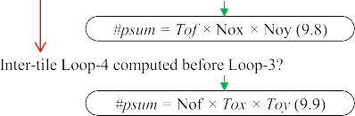
1358
IEEE TRANSACTIONS ON VERY LARGE SCALE INTEGRATION (VLSI) SYSTEMS, VOL. 26, NO. 7, JULY 2018
Having Pm parallel multiplications per cycle requires Pm pixels and Pm weights to be fed into the multipliers. The number of distinct weights required per cycle is
Pwt = Pof × Pif × Pkx × Pky. (9)
If Loop-1 is not unrolled (Pkx = 1, Pky = 1), the number
RicardoNid
2020-10-05 23:01:48
--------------------------------------------
这些数据都可以通过模型中的"设计变量"得 出
of distinct pixels required per cycle (Ppx) is
Ppx = Pif × Pix × Piy. (10)
Otherwise, Ppx is
Ppx = Pif × ((Pix − 1)S + Pkx) × ((Piy − 1)S + Pky). (11)
Note that “distinct” only means that the pixels/weights are from different feature/kernel map locations and their values may be the same. The number of times a weight is spatially reused in one cycle is
Reuse_wt= Pm/Pwt = Pix × Piy (12)
where
the spatial reuse of weights is realized by unrolling
Loop-3 (Pix > 1 or Piy > 1). The number of times of a pixel
is spatially reused in one cycle (Reuse_px) is
Reuse_px = Pm/Ppx. (13)
If Loop-1 is not unrolled, Reuse_px is
Reuse_px = Pof
otherwise, Reuse_px is
Fig. 9. Design space exploration of the total number of partial sums that need to be stored in memory [15].
(14)
Reuse_{px} =
Pof × Pkx × Pky × Pix × Piy
.
within this tile as described in (9.2)–(9.5) inside Fig. 9. In this
((Pix − 1)S + Pkx) × ((Piy − 1)S + Pky)
(15)
case, the number of partial sums, determined by P∗ or T∗,
The
spatial reuse of pixels is realized by either unrolling
is small and can be stored in local registers [(9.2) inside
Loop-4 (Pof > 1)
or unrolling both Loop-1 and Loop-
Fig. 9] or in on-chip buffers [(9.3) inside Fig. 9]. If the loop tile cannot include all data for Loop-1 and Loop-2, partial sums from one tile need to be stored in on-chip or off-chip memory until it is consumed by another tile as in (9.6)–(9.9) inside Fig. 9. In this case, the partial sums need to be stored in on-chip buffers [(9.6) inside Fig. 9] or even in external memory [(9.7) inside Fig. 9]. The loop computing order also
3 together. Only unrolling Loop-1 (Pix = 1, Piy = 1) or only
unrolling Loop-3 (Pkx = 1, Pky = 1) hampers reusing pixels,
and Reuse_px = Pof.
 | If intra-tile Loop-3 is computed first, the weights can be
reused for Tox × Toy/(Pox × Poy) consecutive cycles. If intra-
tile Loop-4 is computed first, the pixels can be reused for
Tof/Pof consecutive cycles.
RicardoNid
2020-10-05 23:07:59
--------------------------------------------
computed first = 不被打断
affects the number of partial sums, and the earlier Loop-1 and
Loop-2 are computed, the fewer is the number of partial sums.
D. Access of On-Chip Buffer
With the data reuse, the number of on-chip buffer accesses can be significantly reduced. Without any data reuse, the total read operations from on-chip buffers for both pixels and weights are N m, as every multiplication needs one pixel and one weight. With data reuse, the total number of read operations from on-chip buffers for weights becomes
The requirement to store partial sums in different levels of memory hierarchy significantly worsens data movements and associated energy cost [8] since partial sums involve both read and write memory operations and typically require higher precision than pixels and weights.
C. Data Reuse
Reusing pixels and weights reduces the number of read
#read_wt = Nm/Reuse_wt
and the total number of read operations for pixels is #read_px = Nm/Reuse_px.
(16)
operations of on-chip buffers. There are mainly two types
of data reuse: spatial reuse and temporal reuse. Spatial reuse
(17)
means that, after reading data from on-chip buffers, a single pixel or weight is used for multiple parallel multipliers within
If the final output pixels cannot be obtained within one
one clock cycle. On the other hand, temporal reuse means
tile, their partial sums are stored in buffers. The number of write and read operations to/from buffers for partial sums per cycle is 2 × Pof × Pox × Poy, where all partial sums
that a single pixel or weight is used for multiple consecutive
cycles.

Slide 6
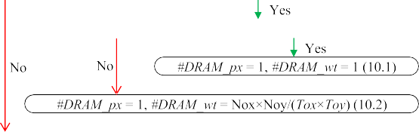
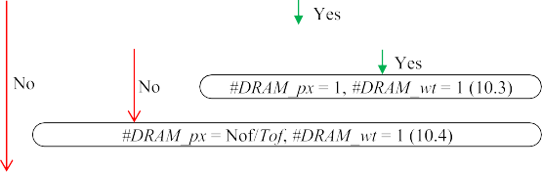


MA et al.: OPTIMIZING CONVOLUTION OPERATION TO ACCELERATE DEEP NEURAL NETWORKS ON FPGA
1359
generated by Loop-1 (Pkx, Pky) and Loop-2 (Pif) are already summed together right after multiplications. The total number of writes/reads to/from buffers for partial sums is
#wr_rd_ psum= #_cycles×(2 × Pof × Pox × Poy). (18)
The number of times output pixels are written to on-chip buffers (i.e., #write_px) is identical to the total number of output pixels in the given CNN model. Finally, the total number of on-chip buffer accesses is
#bu f f er _access = #read_ px + #read_wt
+ #wr _rd_ psum + #write_ px. (19)
E. Access of External Memory
In our analysis, both the weights and intermediate results of pixels are assumed to be stored in external memory (DRAM), which is a necessity when mapping large-scale CNNs on moderate FPGAs. The costs of DRAM accesses are higher latency and energy than on-chip block RAM (BRAM) memory accesses [8], [20], and therefore it is important to reduce the number of external memory accesses to improve the overall performance and energy efficiency. The minimum number of DRAM accesses is achieved by having sufficiently large on-chip buffers and proper loop computing orders, such that every pixel and weight needs to be transferred from DRAM only once. Otherwise, the same pixel or weight has to be read multiple times from DRAM to be consumed for multiple tiles.
The flowchart to estimate the number of DRAM accesses is shown in Fig. 10, where #DRAM_px and #DRAM_wt denote the number of DRAM access of one input pixel and one weight, respectively. After fetched out of DRAM, all data should be exhaustedly utilized before being kicked out of the buffer. Therefore, if the tile size or the on-chip buffer can
Fig. 10. Design space exploration of the number of external memory accesses.
feature maps. However, kernel size (Nkx × Nky) is normally
RicardoNid
2020-10-06 00:41:46
--------------------------------------------
潜台词是采用中央式设计
very small (≤11 × 11) so that it cannot provide sufficient
parallelism and other loops need to be further unrolled. A more
challenging problem is that kernel size may vary considerably
across different convolution layers in a given CNN model (e.g.,
AlexNet [2], ResNet [5]), which may cause workload imbal- ance and inefficient utilization of the PEs [21]. To address this,
fully cover either all input pixels or all weights of one layer,
PEs need to be configured differently for layers with different kernel sizes [10], which increase control complexity.
In type-(C), every row in the kernel window is fully unrolled
the minimum DRAM access can be achieved as (10.8) inside
Fig. 10. By computing Loop-3 first, weights stored in buffer
(Pkx = Nkx) and Loop-3 is also partially unrolled. By this
are reused and #DRAM_wt is reduced as in (10.1) and (10.5) inside Fig. 10. Similarly, by computing Loop-4 first, pixels can be reused to reduce #DRAM_px as in (10.3) and (10.6)
means, pixels can be reused by the overlapping caused by Loop-1 and Loop-3 as in (15), and weight reuse can also be realized by unrolling Loop-3 as in (12). However, Loop-4 is not unrolled and further pixel reuse cannot be achieved. The PE efficiency issue caused by unrolling Loop-1 also affects type-(C) [21].
In type-(A) and type-(B), Loop-3 is not unrolled, which implies that weights cannot be reused. Type-(B) only unrolls
inside Fig. 10. However, computing Loop-3 or Loop-4 first
RicardoNid
2020-10-06 00:41:09
--------------------------------------------
各个level优先的pros and cons
may postpone the computation of Loop-1 or Loop-2, which
would lead to a large number of partial sums.
IV. LOOP OPTIMIZATION IN RELATED WORKS
In this section, the acceleration schemes of the state-of- the-art hardware CNN accelerators are compared. The loop unrolling strategy of current designs can be categorized into the four types:
[Type-(A)] unroll loop-1, loop-2, loop-4 [11], [13], [17], [19];
[Type-(B)] unroll loop-2, loop-4 [9], [14];
3) [Type-(C)] unroll loop-1, loop-3 [7], [8], [21];
4) [Type-(D)] unroll loop-3, loop-4 [15], [16], [18].
By unrolling Loop-1, Loop-2, and Loop-4 in type-(A), parallelism is employed in kernel maps, input and output
Loop-2 and Loop-4, but Nif × Nof of the first convolution
layer is usually small (≤3 × 96) and cannot provide sufficient
parallelism, which results in low utilization and throughput. If the first layer is computation bounded or the DRAM delay is not overlapped with the computation, the throughput degradation will affect the overall performance, especially for shallow CNNs, e.g., AlexNet and NiN.
In type-(D), both Loop-3 and Loop-4 are unrolled so that
both pixels and weights can be reused. In addition, Nox ×
Noy × Nof (≥7 × 7 × 64) is very large across all the
convolution layers in AlexNet, VGG, and ResNet so that high

Slide 7
1360
IEEE TRANSACTIONS ON VERY LARGE SCALE INTEGRATION (VLSI) SYSTEMS, VOL. 26, NO. 7, JULY 2018
level of parallelism can be achieved even for largest FPGA
D. Minimizing Access of External Memory
As we first compute Loop-1 and Loop-2 to reduce partial sums, we cannot achieve the minimum number of DRAM access described in (10.1) and (10.3) inside Fig. 10, where neither the pixels nor the weights are fully buffered for one convolution layer. Therefore, we can only attain the minimum DRAM access by assigning sufficient buffer size for either all pixels or all weights of each layer as in (10.8) inside Fig. 10.
Then, the optimization of minimizing the on-chip buffer size while having minimum DRAM access is formulated as
min bits_BU F _ px _wt
available with ∼3600 DSP slices. By this means, a uniform
configuration and structure of PEs can be applied for all the convolution layers.
Loop tiling has been used in prior hardware CNN accel- erators to fit the large-scale CNN models into limited on- chip buffers. However, only a few prior works [13], [18] have shown their tiling configurations that determine the on-chip buffer size, but the tradeoff between the loop tiling size and the number of external memory accesses is not explored.
The impact of loop interchange has not been rigorously studied in prior works, but it can greatly impact the number
of partial sums as well as the resulting data movements and memory access.
s.t. #Tile_px_{L} = 1or #Tile_wt _{L} = 1
with ∀L ∈ [1, #CO NV s] (20)
where #Tile_px_{L} and #Tile_wt_{L} denote the number of tiling blocks for input pixels and weights of layer L, respec- tively, and #CONVs is the number of convolution layers. bits_BUF_px_wt is the sum of pixel buffer size (bits_BUF_px) and weight buffer size (bits_BUF_wt), which are given by
bits_BU F _px_wt = bits_BU F _px + bits_BU F _wt. (21)
Both pixel and weight buffers need to be large enough to cover the data in one tiling block for all the convolution layers.
This is expressed as
bits_BU F _px
V. PROPOSED ACCELERATION SCHEME
The optimization process of our proposed acceleration scheme is presented in this section, which includes appropriate selection of the convolution loop design variables.
A. Minimizing Computing Latency
We set variables P∗ to be the common factors of T∗ for all
the convolution layers to fully utilize PEs, and T∗ to be the
common factors of N∗ to make full use of external memory
transactions. For CNN models with only small common fac-
= MAX(wor ds_px_{L})
tors, it is recommended to set JN∗/T∗] − N∗/T∗ and JT∗/P∗]
× pi xel_datawidth with L ∈ [1, #CO NV s] (22)
− T∗/P∗ as small as possible to minimize the inefficiency
caused by the difference in sizes of CNN models.
bits_BU F _wt
= MAX(wor ds_wt _{L})
×weight_datawidth with L ∈ [1, #CO NV s] (23)
B. Minimizing Partial Sum Storage
To reduce the number and movements of partial sums, both Loop-1 and Loop-2 should be computed as early as possi- ble or unrolled as much as possible. To avoid the drawback of unrolling Loop-1 as discussed in Section IV and maximize the data reuse as discussed in Section III-C, we decide to unroll Loop-3 (Pox > 1 or Poy > 1) and Loop-4 (Pof >1). By this means, we cannot attain the minimum partial sum storage, as (9.1) inside Fig. 9.
where words_px_{L} and words_wt_{L} denote the number of pixels and weights of one tiling block in layer L, respectively. These are expressed in terms of loop tiling variables as follows:
wor ds_px_{L} = Tix _{L} ×Tiy_{L} ×Tif _{L} +Tox_{L} ×Toy_{L} ×Tof_{L}
(24)
(25)
wor ds_wt _{L} = Tof _{L} ×Tif _{L} ×Tkx _{L} ×Tky_{L}
Constrained by 1 ≤ P∗≤ T∗≤ N∗, the second least number
where words_px_{L} is comprised of both input and output pixels. The number of tiles in (20) is also determined by T∗ variables
of partial sum storage is achieved by (9.2) among (9.2)–(9.9) inside Fig. 9. To satisfy the condition for (9.2), we serially compute Loop-1 and Loop-2 first and ensure the required data
#Tile_px_{L} = JNif _{L}/Tif _{L} ]× JNox_{L} /Tox_{L} ]× JNoy_{L} /Toy_{L} ]
of Loop-1 and Loop-2 are buffered, i.e., Tkx = Nkx, Tky =
(26)
Nky and Tif = Nif . Therefore, we only need to store Pof ×
#Tile_wt_{L} = JNkx _{L}/Tkx _{L} ]× JNky_{L} /Tky_{L} ]× JNif _{L}/Tif _{L} ]
Pox × Poy number of partial sums, which can be retained in
×JNof _{L}/Tof _{L} ]. (27)
local registers with minimum data movements.
By solving (20), we can find an optimal configuration of
T∗ variables that result in minimum DRAM access and on-
C. Minimizing Access of On-Chip Buffer
The number of on-chip buffer accesses is minimized by unrolling Loop-3 to reuse weights as shown in (12) and unrolling Loop-4 to reuse pixels as shown in (14). As our partial sums are kept on local registers, they do not add overhead to the buffer access and storage.
chip buffer size. However, since we have already set Tkx =
Nkx, Tky = Nky, Tif = Nif as in Section V-B, we can only
achieve a suboptimal solution by tuning Tox, Toy and Tof, resulting in larger buffer size requirement. If the available
on-chip memory is sufficient, we set Tox = Nox so that an
entire row can be buffered to benefit the direct memory access (DMA) transactions with continuous data.

Slide 8













MA et al.: OPTIMIZING CONVOLUTION OPERATION TO ACCELERATE DEEP NEURAL NETWORKS ON FPGA
1361
Fig. 12. Optimized loop unrolling and tiling strategy. The parallelism is within one feature map (Pox × Poy) and across multiple kernels (Pof). The tiling variables Tiy, Toy, and Tof can be tuned that decide the buffer sizes.
Fig. 11. To guarantee minimum DRAM accesses, either all pixels (blue bars) are covered by pixel buffers (blue dashed lines) or all weights are covered by weight buffers in one layer. Then, we try to lower the total buffer sizes/lines. (a) Pixels and weights distribution of convolution layers in VGG-
16. (b) Pixels and weights distribution of convolution layers in ResNet-50.
E. Optimized Loop Design Variables
According to the aforementioned optimization process, we propose a convolution acceleration scheme for a high- performance and low-communication CNN accelerator, which is visualized in Fig. 12.
Loop Unrolling: For all the convolution layers, Loop-
Finally, we have to solve (20) by searching Toy and Tof, because it has a nonlinear objective function and constraints with integer variables. Since Toy and Tof in VGG-16 con-
1 and Loop-2 are not unrolled, which means Pkx = 1, Pky =
1 and Pif = 1. According to (7) and (8), Pox, Poy and Pof are
set to be the common factors of the feature maps (Nox, Noy) and output channels (Nof), respectively, to fully utilize the multipliers. The configurations of Pox, Poy, and Pof of different CNNs on different FPGAs are listed in Table II, which are largely constrained by the available computing resources.
sist of 2 × #CONVs = 26 variables and each variable
can have about four candidate values constrained by T∗/P∗
= integer and N∗/T∗ = integer, the total number of Toy
and Tof configurations is about 4²⁶ = 4.5 × 10¹⁵, which
By setting P∗ to be constant across all the convolution layers,
becomes an enormous solution space. In ResNet-50/ResNet- 152, the #CONVs are increased to be 53 and 155, respectively, which makes the solution space even larger to be about
a uniform structure and mapping of PEs can be realized to reduce the architecture complexity.
4¹⁰⁶ = 6.6 × 10⁶³ and 4³¹⁰ = 4.4 × 10¹⁸⁶, respectively.
2) Loop Tiling: For loop tiling, we set Tkx = Nkx, Tky
Therefore, it is impossible to enumerate all the candidate solutions.
In this paper, we propose to empirically find a satisfactory solution for a given on-chip memory capacity that takes
advantage of the property of CNNs. CNNs normally have large pixel data volume and small weight sizes in the beginning
few layers. As we proceed into deeper layers, the pixel sizes become smaller with extracted features, and the weight sizes
become larger with more channels. This trend is illustrated
in Fig. 11, where the bars denote data sizes in each convolution layer. To benefit from the data distribution property in different layers, we only need to make pixel buffers fully cover the last few layers and weight buffers fully cover the beginning few layers. Then, the middle layers with both relatively large pixel and weight sizes become the constraints of the buffer sizes, and we only need to take care of these bounding layers, which significantly shrinks the solution space. The dashed lines in Fig. 11 are the minimal buffer sizes we found while guaranteeing minimum DRAM accesses, and the bounding layers are pointed out by arrows. If this buffer size still cannot be fit into the FPGA on-chip memory, then we need to either change the tiling strategy or decrease the buffer sizes at the cost of more DRAM accesses as discussed in [15].
= Nky, Tif = Nif as described in Section V-B and shown
in Fig. 12 so that data used in Loop-1 and Loop-2 are all
buffered and Tox = Nox to benefit DMA transfer. Details of
Toy and Tof are described in Section V-D.
3) Loop Interchange: For loop interchange, we first serially compute Loop-1 and then Loop-2 as described in Section V-B. Finally, we compute Loop-3 and Loop-4, where the exact com- putation order of these two loops does not have a pronounced impact on the cost, based on our P∗ and T∗ choices.
VI. PROPOSED CNN ACCELERATOR
To implement the optimized convolution acceleration scheme in Section V-E, a data router is proposed with high flexibility for different convolution sliding settings, e.g., strides and zero paddings, using variant data buses. A corresponding hardware PE architecture is also designed that minimizes on/off-chip memory accesses and data movements.
A. Data Bus From Buffer to PE (BUF2PE)
In [15] and [16], a register array architecture is designed to rearrange and direct the pixel stream from buffers into PEs. This method takes advantage of convolution stride being

Slide 9
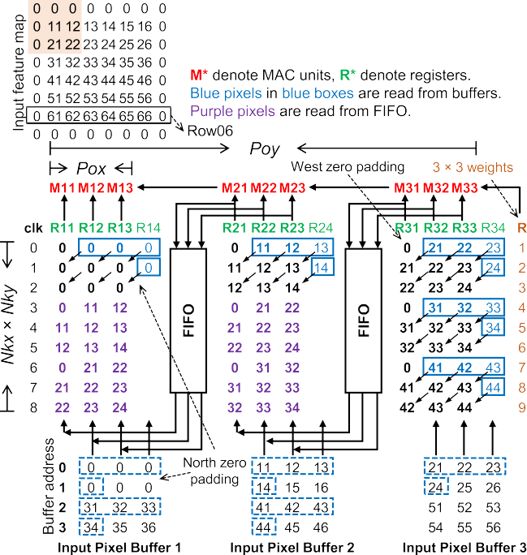

1362
IEEE TRANSACTIONS ON VERY LARGE SCALE INTEGRATION (VLSI) SYSTEMS, VOL. 26, NO. 7, JULY 2018
TABLE II
OUR IMPLEMENTATION OF DIFFERENT CNNS ON DIFFERENT FPGAS
1 in VGG-16 so that pixels can be reused by the adja- cent register array in the next computing cycles. However, if stride is 2 or more, which frequently occurs in CNN algorithms [2], [3], [5], pixels need to wait for Nkx × (Stride-
1) cycles to be reused by the neighboring register array. This makes the control logic and wire routing among registers much more complicated. Therefore, we propose a BUF2PE data bus in Fig. 13 to implement the dataflow using FIFO to temporally store pixels to be reused by the adjacent register array. This method is similar to line buffer design in [22], where FIFOs are used to align pixels from multiple feature rows to a kernel window so that parallelism can be employed within a kernel window, i.e., unrolling Loop-1, whereas this paper unrolls Loop-3 to parallel compute within one feature map. By this means, the wire routing within and across register arrays is simplified, and the data router can follow the same pattern for convolution with different strides and zero paddings to improve the accelerator flexibility.
The detailed design of BUF2PE data bus is illustrated in Fig. 13. Pixels from input buffers are loaded into the
corresponding registers as shown by the blue dashed box to the blue solid box. Then, the pixels are sent to PEs or MAC units
and are also sent to FIFOs during cycles 0 to 5, waiting to be
reused by the adjacent register array. Register arrays except the rightmost one start reading input pixels from FIFOs at cycle 3, as shown by the purple pixels in Fig. 13. Meanwhile, the new pixels are fed into the rightmost register array from buffers. In this paper, the offset caused by west zero padding is handled by shifting the connection between buffers and register arrays, whereas [15] has to change the storage pattern within one address of input buffer by a padding offset that increases the complexity of transferring data from DRAM to buffers.
The coarse-grained dataflow is shown in Fig. 14 at feature
Fig. 13. BUF2PE data bus directs the convolution pixel dataflow from input buffers to PEs (i.e., MAC units), where Pox = 3 and Poy = 3.
with stride = 2 and zero padding = 3 is shown, which follows
the same pattern as the case with stride = 1. The buffer storage
pattern is adjusted according to different stride and padding settings. Three rows of zeros are added to the buffer due
to the north zero padding of 3. With stride = 2, every two
map row level for stride = 1 and stride = 2. The data flow in
rows of pixels are continuously distributed across Poy buffer banks. These adjustments are handled by the buffer write enable and address signals during the reception of pixels from DRAM. Since the data movement within a register array or a
Fig. 14(a) is the same as Fig. 13, where more clock cycles of operation is shown after cycle 8. In Fig. 14(b), the dataflow

Slide 10
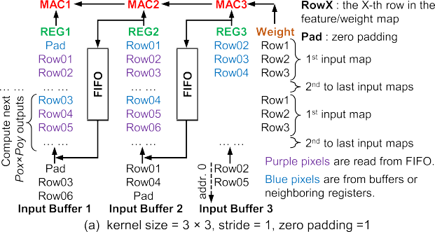










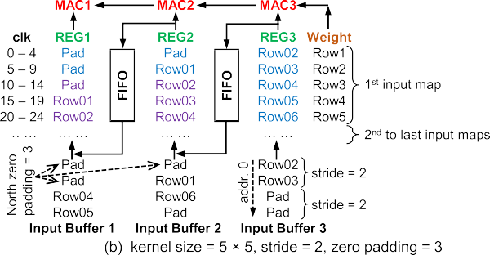



MA et al.: OPTIMIZING CONVOLUTION OPERATION TO ACCELERATE DEEP NEURAL NETWORKS ON FPGA
1363
Fig. 15. Convolution acceleration architecture with Pox × Poy × Pof MAC units.
minimized. Pixels read from input pixel buffers are shared by Pof MAC units and sliding overlapped pixels are also reused by the data router. Weights read from weight buffers are
Fig. 14. Coarse-grained designs of BUF2PE data buses for (a) strides =
shared by Pox × Poy MAC units. The proposed architecture is
1 and zero padding = 1 and (b) stride = 2 and zero padding = 3.
feature map row is different for different settings of stride and zero padding, various BUF2PE data buses are needed for each dataflow, and the set of data buses are called data router. If these settings are identical, one BUF2PE bus can
implemented with parameterized Verilog codes and is highly scalable to different CNN models in FPGAs or even ASICs by modifying design variables such as Pox, Poy and Pof.
After the completion of Loop-1 and Loop-2, the partial sums need to be added with biases as in Fig. 1 to obtain the final
handle different kernel sizes (Nkx × Nky) without penalty
output pixels. Therefore, every Nkx × Nky × Nif cycles, MAC
of idle cycles as we serially compute Loop-1. Therefore, the BUF2PE bus in Fig. 14(b) can be applied for conv1 in
units output the partial sums into the adders to add with biases.
Since Poy < Nkx × Nky × Nif for all the layers, we serialize
ResNet with stride = 2 and zero padding = 3. For other
the Pox × Poy × Pof MAC outputs into Poy cycles. Then,
sliding settings in ResNet, e.g. stride = 2 and zero padding =
we only need Pox × Pof adders to add the biases in parallel.
0, the corresponding variants of BUF2PE buses are designed to direct the dataflow. The global control logic controls the switch among different BUF2PE buses inside the data router.
The data width of one output buffer can also be reduced to be Pox, and we store the pixels of one output feature map in one buffer bank, which could need totally Pof output buffers.
After Nkx × Nky cycles, we complete one kernel window
If Pof is large, e.g., Pof = 64, it would require many output
sliding (Loop-1) and move to the next input feature map with
buffers with shallow depth, resulting in low utilization of on- chip BRAMs (e.g., M20K memory block). In addition, batch
the same dataflow until the last one as shown in Fig. 14.
normalization (Bnorm) layers in ResNet still need Pox × Pof
After Nkx × Nky ×Nif cycles, both Loop-1 and Loop-2 are
adders and multipliers that are expensive. We further serialize
completed and we obtain Pox × Poy × Pof final output
the Pox × Pof parallel outputs to be Pox × #OUTBUF using
pixels.
multiplexers with neighboring output feature maps stacked in one output buffer, as illustrated in Fig. 15. In ResNet, we set
In summary, the proposed dataflow is scalable to Nkx ×
Nky by changing the control logic, and it can handle various sliding settings using variant BUF2PE data buses inside the data router, where the MAC units are reused and kept busy.
#OUTBUF = 16 to ensure Poy × Pof / (#OUTBUF) < Nkx
× Nky × Nif or the number of serial output cycles is smaller
B. Convolution PE Architecture
The PE architecture of convolution layers shown in Fig. 15 is designed according to the proposed acceleration
than the MAC unit output interval cycles. By this means, the parallelism of adders and multipliers for bias and Bnorm is significantly reduced, as well as the output buffer bandwidth and the used M20K BRAMs.
strategy and dataflow. It is comprised of Pox × Poy × Pof
C. Pooling Layers
Pooling is commonly used to reduce the feature map dimen-
PEs, and every PE in our architecture is an independent MAC unit consisting of one multiplier followed by an accumulator. As Loop-1 and Loop-2 are not unrolled, no adder tree is needed to sum the multiplier outputs. The partial sum is consumed inside each MAC unit until the final results are obtained, such that the data movements of partial sums are
sion by replacing pixels within a kernel window (e.g., 2 × 2,
3 × 3) by their maximum or average value. The output pixels
from previous convolution layers are stored row-by-row in the output pixel buffers. As pooling operation only need pixels,

Slide 11
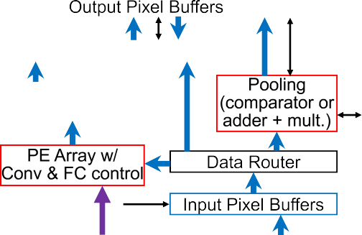
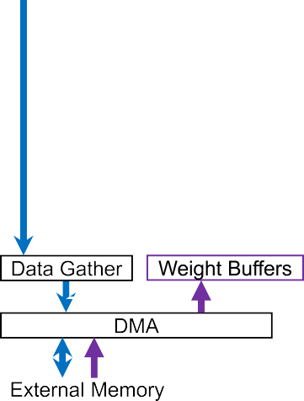






1364
IEEE TRANSACTIONS ON VERY LARGE SCALE INTEGRATION (VLSI) SYSTEMS, VOL. 26, NO. 7, JULY 2018
after one tile of convolution is finished, we directly compute pooling with pixels read from output pixel buffers to eliminate the access of external memory. The unrolling factors of all the pooling layers are the same. Since the width of output pixel buffer is Pox, we can enable Pox × #OUTBUF parallel pooling operations, which is large enough considering that pooling layers involve much less operations compared to convolution layers. Register arrays are used to reshape the pooling input pixels and ensure continuous feeding of pixels into pooling PEs without idle cycles. The PEs are either comparators for max pooling or accumulators followed by constant coefficient multipliers for average pooling. The outputs of pooling are written back to the output pixel buffers and then transferred to the external memory.
D. Fully Connected Layers
The inner-product layer or fully connected (FC) layer is
a special form of the convolution layer with Nkx = Nky
= Nox = Noy = 1, or there are no Loop-1 and Loop-3.
Fig. 16. Overall FPGA-based CNN hardware acceleration system [16].
Therefore, we only unroll Loop-4 and reuse the same MAC unit array used in convolution layers for all the FC layers. Contrary to convolution layers, FC layers have large amount of weights but small amount of operations, which makes the throughput of FC layers primarily bounded by the off- chip communication speed. Due to this, dual weight buffers can be used to overlap the inner-product computation with off-chip communication to increase FC throughput. However, in recent CNN models, e.g., ResNet, the size of FC weights
not synthesized, and the dataflow just bypasses this module. With two DRAM banks, both kernel and feature maps are separated into these two banks to enable full off-chip commu- nication. Two Modular scatter-gather DMA engines provided by Intel are used to simultaneously read and write from/to these two DRAM banks. Data scatter and gather [16] are used to distribute the data stream from DMA into multiple input buffers and collect data from multiple output buffers into one DMA stream, respectively. After the input images and weights are loaded into DRAMs, the CNN inference acceleration process starts. When the computation of one loop tile completes, the output pixels are transferred to DRAM, and then the weights and pixels for the next loop tile are loaded from DRAM to on-chip buffers. The controller governs the iterations of the four convolution loops and the layer-by-layer sequential computation. The buffer read and write addresses are also generated by the controller.
The fixed-point data representation is used, and both pixels and weights are 16-bit. The decimal points are dynamically adjusted according to the ranges of pixel values in different layers to fully utilize the existing data width [13]. By this means, the top-1 and top-5 ImageNet classification accuracy degradation is within 2% compared with software floating- point implementation [10]–[14].
(= 2 M) has been significantly reduced compared to that of
VGG (= 123.6M), and FC layers are completely removed
in NiN [3]. Considering this trend that CNNs are decreasing their reliance on FC layers and the relatively smaller number of FC operations, the dual buffer techniques are not used in this paper. We reuse the convolution weight buffers for FC weights and start the FC computations after the weights are read from DRAM. Thus, in VGG implementation, FC layer has a significant contribution to the overall system latency. FC layer output pixels are directly stored in on-chip buffers as their size is small (<20 kB).
VII. EXPERIMENTAL RESULTS
A. System Setup
The proposed hardware CNN inference accelerator is demonstrated by implementing NiN [3], VGG-16 [4], and ResNet-50/ResNet-152 [5] CNN models on two Intel FPGAs. The two Intel FPGAs, e.g., Stratix V GXA7 / Arria 10 GX 1150, consist of 234.7K/427.2K adaptive logic mod- ules (ALMs), 256/1,518 DSP blocks and 2,560/2,713 M20K BRAM blocks, respectively. The underlying FPGA boards for Stratix V and Arria 10 are Terasic DE5-Net and Nallatech 385A, respectively, and both are equipped with two banks of 4GB DDR3 DRAMs.
The overall CNN acceleration system on the FPGA chip shown in Fig. 16 is coded in parametrized Verilog scripts
and configured by the proposed CNN compiler in [16] for different CNN and FPGA pairs. If a layer does not exist
in the CNN model, the corresponding computing module is
B. Analysis of Experimental Results
The performance and specifications of our proposed CNN accelerators are summarized in Table II. In Stratix V and Arria 10, one DSP block can be configured as either two independent
18-bit × 18-bit multipliers or one multiplier followed by an
accumulator, i.e., one MAC. Since one multiplier consumes much more logic than one adder, we use the DSP as two independent multipliers and implement the accumulator inside
the MAC unit by ALMs. Since Arria 10 has 1.8× more
ALMs and 5.9× more DSP blocks than the Stratix V we
use, larger loop unrolling variables (Pox × Poy × Pof) can be
achieved in Arria 10 to obtain >2× throughput enhancement
than Stratix V.

Slide 12









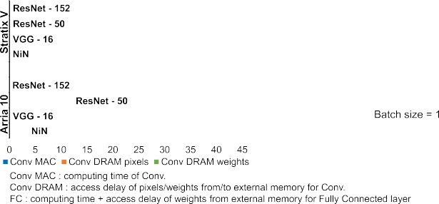

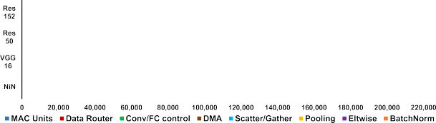
MA et al.: OPTIMIZING CONVOLUTION OPERATION TO ACCELERATE DEEP NEURAL NETWORKS ON FPGA
1365
TABLE III
PREVIOUS CNN FPGA IMPLEMENTATIONS
Compared with [15], the unrolling variables, i.e., Pox × Poy × Pof, of VGG-16 are set to be 7 × 7 × 64 on Arria 10 instead of 14 × 14 × 16, where the number of MAC units (= 3136) are the same and both sets of P∗ variables are the common factors of the feature/kernel map sizes resulting in the same computation cycles. The data router in Fig. 13 and the data buses after MAC units in Fig. 15 are only related with Pox and Poy, whereas the data buses related with Pof from weight buffers to MAC units in Fig. 15 are relatively simple. To reduce the data bus width and required logic, we choose
smaller Pox × Poy in this work as 7 × 7 with a larger Pof
Fig. 17. Latency breakdown per image of NiN, VGG-16 and ResNet- 50/152 on Stratix V and Arria 10 FPGA platforms [16].
as 64. Since the greatest common factors of feature/kernel
maps, e.g., Nox × Noy × Nof, of all Convolution (Conv.) layers in ResNets are 7×7×64, we still set Pox × Poy × Pof to be 7 × 7 × 64. Since ResNets have more complex structure and
more types of layers, e.g., Eltwise and Bnorm, they consume more logic elements than NiN and VGG-16 on Arria 10 and cannot achieve the same parallel degree as NiN and VGG-16 on Stratix V. Since two FPGAs have close capacity of on-chip
BRAMs, the loop tiling variables (T ∗) of the same CNN is
Fig. 18. Logic utilization breakdown of NiN, VGG-16 and ResNet-50/152.
set to be the same for both FPGAs, which leads to similar BRAM consumption.
The breakdown of the processing time per image of each
the same amount of ALMs. As VGG-16 is highly uniform
with only one convolution sliding setting, e.g., stride = 1 and
CNN is shown in Fig. 17 with batch size = 1. The MAC
padding = 1, only one BUF2PE bus is needed, which leads to
computation time of convolution layers, e.g., “Conv MAC,” dominates the total latency by over 50%. “Conv DRAM” includes DRAM transaction delay of convolution weights and input–output pixels. The FC latency includes the inner- product computation delay and the DRAM transfer delay of FC weights. “Others” include the delay of average pooling, element-wise and pipeline stages.
The logic utilization in ALMs of each module is shown in Fig. 18. Most multipliers in MAC units are implemented by DSPs, and logic elements are mainly used to implement accumulators in MAC units. With the same parallel compu- tation degree, the MAC units of the four CNNs use about
less logic and BRAM consumption of data router compared to NiN and ResNets. Convolution and FC layers share the MAC units but have their own control logic to govern the sequential operations. Eltwise layers use adders to element- wise add pixels from two branches of layers. “Others” include the system interconnections, global control logic, bias adders, and configuration registers.
C. Comparison With Prior Works
The reported results from recent CNN FPGA accelerators are listed in Table III. Rahman et al. [18] only implement convolution layers in AlexNet and uses the similar strategy as

Slide 13
1366
IEEE TRANSACTIONS ON VERY LARGE SCALE INTEGRATION (VLSI) SYSTEMS, VOL. 26, NO. 7, JULY 2018
us to unroll Loop-3 and Loop-4, which can also achieve high DSP utilization. In [10] and [17], the layer-by-layer computa- tion is pipelined using different part of one or multiple FPGAs resources to improve hardware utilization and thus throughput. However, with the highly increasing number of convolution layers [5], it becomes very difficult to map different layers onto different resources and balance the computation among all the pipeline stages. In addition, pipelining can increase the throughput but not necessarily the latency. Batch computing with multiple input images is applied in [8], [10], [12], [17], and [23]. The biggest advantage of this technique is to share the weights transferred from off-chip DRAM among multiple images and thus increase the throughput at the cost of increased latency per image and external memory storage of multiple images. Benefit from batch computing and using 2144 DSP slices, which enables high parallelism degree, Li et al. [17] also achieve high throughput of 565.94 GOPS for AlexNet. In [12], an OpenCL-based CNN accelerator is implemented on Arria10 FPGA, where the Intel FPGA SDK for OpenCL provides a pregenerated platform that ensures timing closure at higher frequency than our RTL design. The Winograd transform is applied for convolution layers
A. Krizhevsky, I. Sutskever, and G. E. Hinton, “ImageNet classification with deep convolutional neural networks,” in Proc. Adv. Neural Inf. Process. Syst. (NIPS), 2012, pp. 1097–1105.
M. Lin, Q. Chen, and S. Yan. (Mar. 2014). “Network in net-
work.” [Online]. Available: https://arxiv.org/abs/1312.4400
K. Simonyan and A. Zisserman, “Very deep convolutional net- works for large-scale image recognition,” in Proc. Int. Conf. Learn. Represent. (ICLR), 2015.
K. He, X. Zhang, S. Ren, and J. Sun, “Deep residual learning
for image recognition,” in Proc. IEEE Conf. Comput. Vis. Pattern Recognit. (CVPR), Jun. 2016, pp. 770–778.
D. F. Bacon, S. L. Graham, and O. J. Sharp, “Compiler transformations
for high-performance computing,” ACM Comput. Surv., vol. 26, no. 4, pp. 345–420, Dec. 1994.
Y.-H. Chen, T. Krishna, J. S. Emer, and V. Sze, “Eyeriss: An energy-
efficient reconfigurable accelerator for deep convolutional neural net- works,” IEEE J. Solid-State Circuits, vol. 51, no. 1, pp. 127–138, Jan. 2017.
Y.-H. Chen, J. Emer, and V. Sze, “Eyeriss: A spatial architecture for
energy-efficient dataflow for convolutional neural networks,” in Proc. ACM/IEEE Int. Symp. Comput. Archit. (ISCA), Jun. 2016, pp. 367–379.
C. Zhang, P. Li, G. Sun, Y. Guan, B. Xiao, and J. Cong, “Optimizing
FPGA-based accelerator design for deep convolutional neural networks,” in Proc. ACM/SIGDA Int. Symp. Field-Program. Gate Arrays (FPGA), Feb. 2015, pp. 161–170.
C. Zhang, D. Wu, J. Sun, G. Sun, G. Luo, and J. Cong, “Energy-efficient
CNN implementation on a deeply pipelined FPGA cluster,” in Proc. ACM Int. Symp. Low Power Electron. Design (ISLPED), Aug. 2016, pp. 326–331.
N. Suda et al., “Throughput-optimized OpenCL-based FPGA accelerator
for large-scale convolutional neural networks,” in Proc. ACM/SIGDA Int. Symp. Field-Program. Gate Arrays (FPGA), Feb. 2016, pp. 16–25.
U. Aydonat, S. O’Connell, D. Capalija, A. C. Ling, and G. R.
Chiu, “An OpenCL deep learning accelerator on Arria 10,” in Proc. ACM/SIGDA Symp. Field-Program. Gate Arrays (FPGA), Feb. 2017, pp. 55–64.
K. Guo et al., “Angel-Eye: A complete design flow for mapping CNN
onto embedded FPGA,” IEEE Trans. Comput.-Aided Des. Integr. Circuits Syst., vol. 37, no. 1, pp. 35–47, Jan. 2018.
Y. Ma, N. Suda, Y. Cao, J.-S. Seo, and S. Vrudhula, “Scalable and
modularized RTL compilation of convolutional neural networks onto FPGA,” in Proc. IEEE Int. Conf. Field-Program. Logic Appl. (FPL), Aug./Sep. 2016, pp. 1–8.
Y. Ma, Y. Cao, S. Vrudhula, and J.-S. Seo, “Optimizing loop opera-
tion and dataflow in FPGA acceleration of deep convolutional neural networks,” in Proc. ACM/SIGDA Int. Symp. Field-Program. Gate Arrays (FPGA), Feb. 2017, pp. 45–54.
Y. Ma, Y. Cao, S. Vrudhula, and J.-S. Seo, “An automatic RTL compiler
for high-throughput FPGA implementation of diverse deep convolutional neural networks,” in Proc. IEEE Int. Conf. Field-Program. Logic Appl. (FPL), Sep. 2017, pp. 1–8.
H. Li, X. Fan, L. Jiao, W. Cao, X. Zhou, and L. Wang, “A high per-
formance FPGA-based accelerator for large-scale convolutional neural networks,” in Proc. IEEE Int. Conf. Field-Program. Logic Appl. (FPL), Aug. 2016, pp. 1–9.
A. Rahman, J. Lee, and K. Choi, “Efficient FPGA acceleration of
convolutional neural networks using logical-3D compute array,” in Proc. IEEE Design, Auto. Test Eur. Conf. (DATE), Mar. 2016, pp. 1393–1398.
M. Motamedi, P. Gysel, V. Akella, and S. Ghiasi, “Design space explo-
ration of FPGA-based deep convolutional neural networks,” in Proc. IEEE Asia South Pacific Design Auto. Conf. (ASP-DAC), Jan. 2016, pp. 575–580.
S. Han et al., “EIE: Efficient inference engine on compressed deep
neural network,” in Proc. ACM/IEEE Int. Symp. Comput. Archit. (ISCA), Jun. 2016, pp. 243–254.
L. Du et al., “A reconfigurable streaming deep convolutional neural
network accelerator for Internet of Things,” IEEE Trans. Circuits Syst. I, Reg. Papers, vol. 65, no. 1, pp. 198–208, Jan. 2018.
B. Bosi, G. Bois, and Y. Savaria, “Reconfigurable pipelined 2-D con-
volvers for fast digital signal processing,” IEEE Trans. Very Large Scale Integr. (VLSI) Syst., vol. 7, no. 3, pp. 299–308, Sep. 1999.
Y. Guan et al., “FP-DNN: an automated framework for mapping deep
neural networks onto FPGAs with RTL-HLS hybrid templates,” in Proc. IEEE Int. Symp. Field-Program. Custom Comput. Mach. (FCCM), Apr./May 2017, pp. 152–159.
X. Wei et al., “Automated systolic array architecture synthesis for high
throughput CNN inference on FPGAs,” in Proc. ACM the 54th Annu. Design Autom. Conf. (DAC), Jun. 2017, pp. 1–6.
that reduces multiplication operations by 2× or improves the
throughput by 2× using the same number of DSPs. The 16-b
floating-point data format is used with shared exponent, which
allows directly using fixed-point 18-bit × 18-bit multipliers for
floating-point operations. Wei et al. [24] proposed an OpenCL- based systolic array architecture to implement convolution on Arria 10, which reduces the global PE interconnect fan-out to achieve high frequency and resource utilization. The VGG-16 throughput of [24] is higher than ours mainly due to: 1) higher frequency; 2) lower precision of weights; and 3) dual buffer scheme to hide DRAM latency. Guan et al. [23] proposed an RTL–HLS hybrid framework to automatically generate FPGA hardware and implements convolution and FC as matrix multiplication. Although the Stratix-V GSMD5 (with
1590 DSP blocks) used in [23] has 6.2× more DSP blocks
than our Stratix-V GXA7, our accelerator on Stratix V can
realize 1.2× higher throughput for ResNet-152 by higher
hardware (DSP and logic) utilization through the proposed loop optimization technique and exploiting logic elements to implement multipliers as well as DSPs.
VIII. CONCLUSION
In this paper, we present an in-depth analysis of convolu- tion loop acceleration strategy by numerically characterizing the loop optimization techniques. The relationship between accelerator objectives and design variables are quantitatively investigated. A corresponding new dataflow and architecture is proposed to minimize data communication and enhance throughput. Our CNN accelerator implements end-to-end NiN, VGG-16, and ResNet-50/ResNet-152 CNN models on Stratix V and Arria 10 FPGA, achieving the overall throughput of 348 GOPS and 715 GOPS, respectively.
REFERENCES
[1] O. Russakovsky et al., “ImageNet large scale visual recognition chal- lenge,” Int. J. Comput. Vis., vol. 115, no. 3, pp. 211–252, 2015.

Slide 14
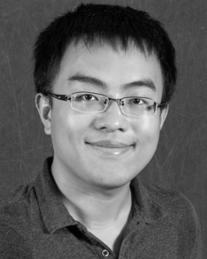
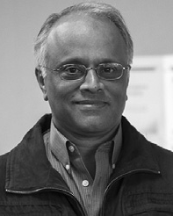
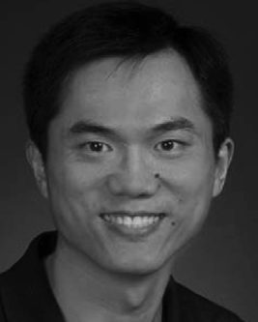
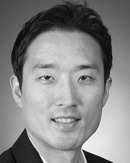
MA et al.: OPTIMIZING CONVOLUTION OPERATION TO ACCELERATE DEEP NEURAL NETWORKS ON FPGA
1367
Yufei Ma (S’16) received the B.S. degree in infor- mation engineering from the Nanjing University of Aeronautics and Astronautics, Nanjing, China, in 2011 and the M.S.E. degree in electrical engineer- ing from the University of Pennsylvania, Philadel-
Sarma Vrudhula (M’85–SM’02–F’16) received the B.Math. degree from the University of Waterloo, Waterloo, ON, Canada, and the M.S.E.E. and Ph.D. degrees in electrical and computer engineering from the University of Southern California, Los Angeles, CA, USA.
He was a Professor at the ECE Department, Uni- versity of Arizona, Tucson AZ, USA, and was on the faculty of the EE-Systems Department at the University of Southern California. He was also the Founding Director of the NSF Center for Low Power
Electronics at the University of Arizona. He is currently a Professor of Computer Science and Engineering with Arizona State University, Tempe, AZ, USA, and the Director of the NSF I/UCRC Center for Embedded Sys- tems. His current research interests include design automation and computer aided design for digital integrated circuit and systems; low-power circuit design; energy management of circuits and systems; energy optimization of battery powered computing systems, including smartphones, wireless sensor networks, and Internet of Things systems that relies energy harvesting; system level dynamic power and thermal management of multicore processors and system-on-chip; statistical methods for the analysis of process variations; statistical optimization of performance, power, and leakage; a new circuit architectures of threshold logic circuits for the design of application-specific integrated circuits and field-programmable gate arrays; nonconventional meth- ods for implementing logic, including technology mapping with threshold logic circuits; the implementation of threshold logic using resistive memory devices; and the design and optimization of nonvolatile logic.
phia, PA, USA, in 2013. He is currently working
toward the Ph.D. degree at Arizona State University,
Tempe, AZ, USA.
His current research interests include the high- performance hardware acceleration of deep learning algorithms on digital application-specified integrated
circuit and field-programmable gate arrays.
Yu Cao (S’99–M’02–SM’09–F’17) | received the
B.S. degree in physics from Peking University,
Beijing, China, in 1996 and the M.A. degree in
biophysics and the Ph.D. degree in electrical engi-
neering from the University of California, |  | Berkeley,
CA, USA, in 1999 and 2002, respectively.
He was a Summer Intern at Hewlett-Packard Labs, Palo Alto, CA, USA, in 2000, and at the IBM Microelectronics Division, East Fishkill, NY, USA, in 2001. He was a Postdoctoral Researcher at the Berkeley Wireless Research Center, University of
California. He is currently a Professor of Electrical Engineering at Arizona State University, Tempe, AZ, USA. He has authored or coauthored numerous articles and two books on Nano-CMOS Modeling and Physical Design. His current research interests include physical modeling of nanoscale technologies, design solutions for variability and reliability, reliable integration of postsili- con technologies, and hardware designs for on-chip learning.
Dr. Cao was a recipient of the 2012 Best Paper Award at the IEEE Computer Society Annual Symposium on VLSI, the 2010, 2012, 2013, 2015, and 2016 Top 5% Teaching Award, Schools of Engineering, Arizona State University, the 2009 ACM SIGDA Outstanding New Faculty Award, the 2009 Promotion and Tenure Faculty Exemplar, Arizona State Univer- sity, the 2009 Distinguished Lecturer of the IEEE Circuits and Systems Society, the 2008 Chunhui Award for outstanding oversea Chinese scholars, the 2007 Best Paper Award at International Symposium on Low Power Electronics and Design, the 2006 NSF CAREER Award, the 2006 and 2007 IBM Faculty Award, the 2004 Best Paper Award at International Symposium on Quality Electronic Design, and the 2000 Beatrice Winner Award at International Solid-State Circuits Conference. He was an Associate Editor of the IEEE Transactions on Computer-Aided Design of Integrated Circuits and Systems. He served on the technical program committee of many conferences.
Jae-sun Seo (S’04–M’10–SM’17) received the B.S. degree in electrical engineering from Seoul National University, Seoul, South Korea, in 2001 and the M.S. and Ph.D. degrees in electrical engineering from the University of Michigan, Ann Arbor, MI, USA, in 2006 and 2010, respectively.
From 2010 to 2013, he was with the IBM
T. J. Watson Research Center, Yorktown Heights, NY, USA, focused on the cognitive computing chips under the DARPA SyNAPSE Project and energy- efficient integrated circuits for high-performance
processors. In 2014, he joined the School of Electrical, Computer and Energy Engineering, Arizona State University, Tempe, AZ, USA, as an Assistant Professor. In 2015, he was with the Intel Circuits Research Labortory as
a Visiting Faculty. His current research interests include efficient hardware design of machine learning and neuromorphic algorithms and integrated power
management.
Dr. Seo was a recipient of the Samsung Scholarship from 2004 to 2009, the IBM Outstanding Technical Achievement Award in 2012, and the NSF CAREER Award in 2017.

